Slide 1
INtroduction
19SW118

Slide 2
ABOUT ME
This is Shahzad from MUET, I'm a prime example of a norm student being average in all realms of academics since the dawn but I don’t want to accept that this is all I that I have to offer, So I aspire to be more career oriented. Please read further for my not so indulging and dry story on how I got to MUET.

Slide 3
roadmap

Slide 4
How did I choose software engineering
After my high school was done, I decided that I'd only do bachelors if the curriculum was software related. I don't know why but I decided that if I would have a career it will only be in software considering the amount of oppurtunies it was bringing keeping in mind how the world was progressing further. So, I only applied in 2 Universities MUET and NED, even though I scored higher in NED I still decided to enrol in MUET away from home not knowing how my journey will commence henceforth.

Slide 5
Technologies

Slide 6
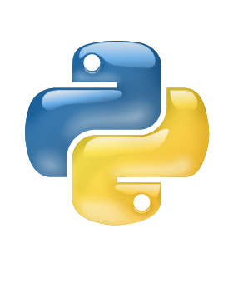
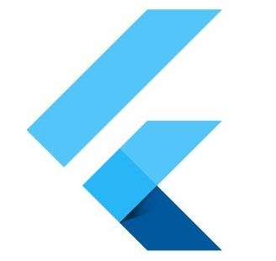
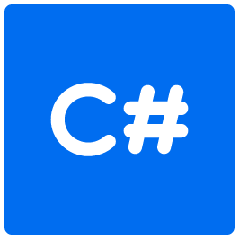
Some technologies which had my interest on the apex
flutter
python
C
Flutter for cross platform mobile application development.
Python for ML and Artificial Intelligence.
C programming for Pen-testing scripts.

Slide 7
python
I decided to learn python because it's said that python is easy to learn comparing to other languages out there, but I've learned that there are no shortcuts to learning. Learning can be really beautiful if you sincerely give it your time and effort. I have surface level knowledge on this technology and I'm not currently practicing python.

Slide 8
C#
There was a time when I was really into ethical hacking, after doing my research I learned that C, C# are one the top languages where you write your hacking scripts such as Pen-testing and other ways of infiltrating on the target adresses. I dropped C# early and I have very little knowledge on the technology.

Slide 9
Flutter
When flutter was released, it was really hot in the market bringing easy cross platform application development which ignited my interest. So, I decided to learn and study flutter. I'd say I have surface level knowledge on the technology but I'm still learning and growing each day. I got to know about this technology through my friends

Slide 10
My final year project is mostly based on Flutter so it gives me an oppurtunity to work on this technology. My project is an E-learning application where we detect emotions of students as well. It takes an AI model integrated into the application, Flutter is really fun to work to with, currently giving this technology my all and hoping that I'd have enough knowledge on the technology by the end of my days here at MUET to be market ready.

Slide 11
Future goals

Slide 12
For my future goals I think I'd like to end up with game development or animations because I have interest in these two the most, I've yet to work on these to build a roadmap that justifies a future and I may still be a long way off but slowly and gradually taking one step at a time I can see myself having a career in these two technologies. I gave data science a thought but mathematics was not really my cup of tea since the origin.

Slide 13
Thankyou :)

